Slide 1
Visualization Examples
Ted Pham
September 8th, 2017

Slide 2
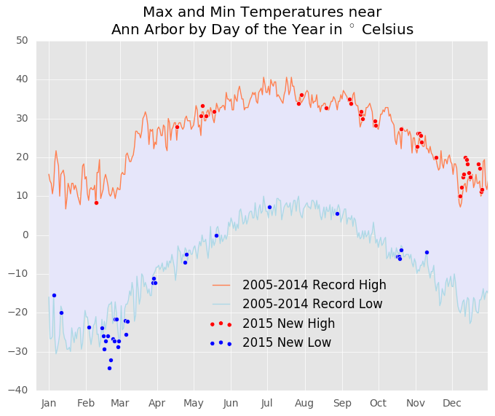
Historical Temperature (Python Matplotlib)

Slide 3
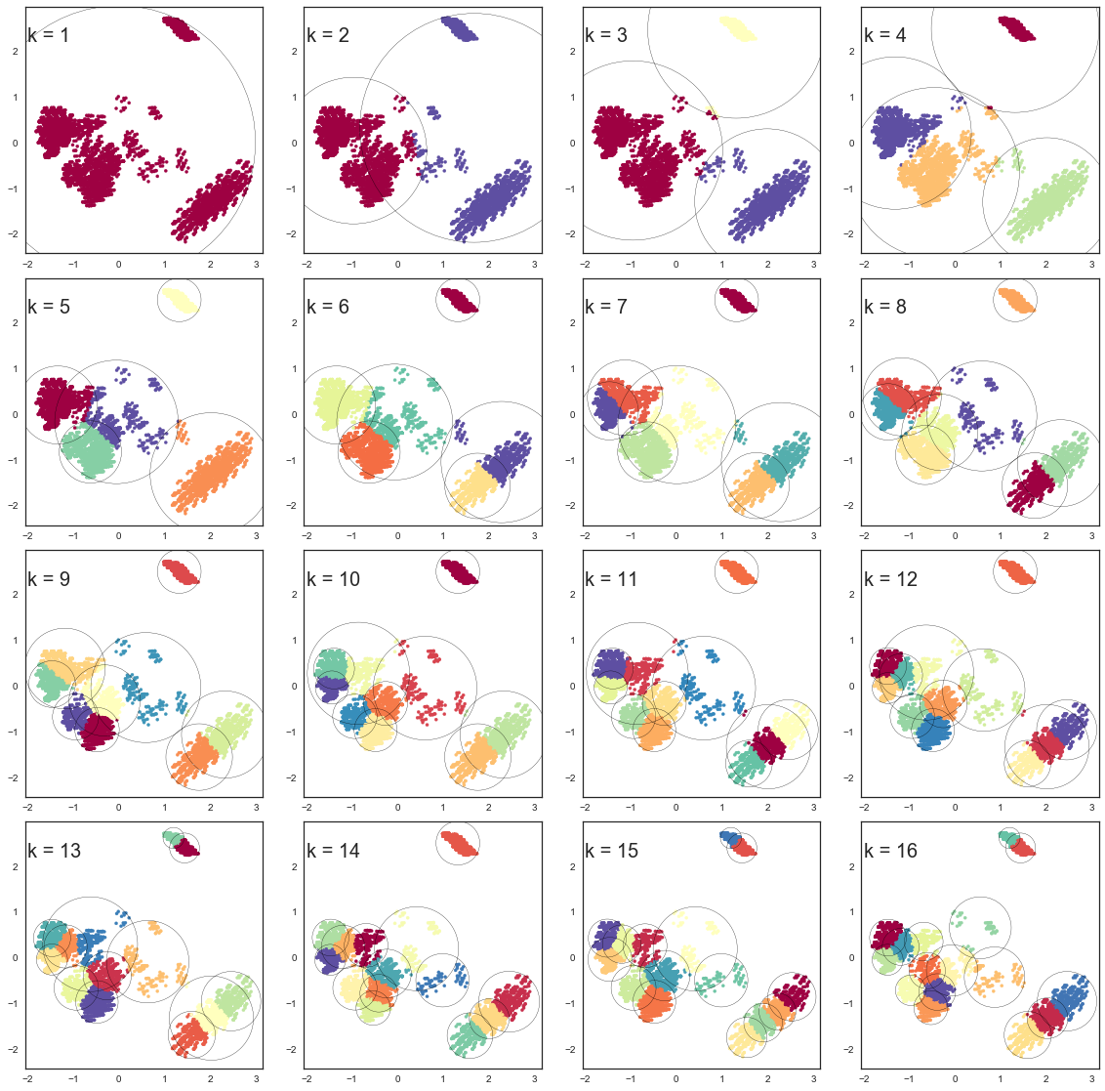
Decision Boundaries on the number of centroids k (Python)
Unsupervised learning algorithm using k-means to identify clusters
k represents the number of clusters

Slide 4
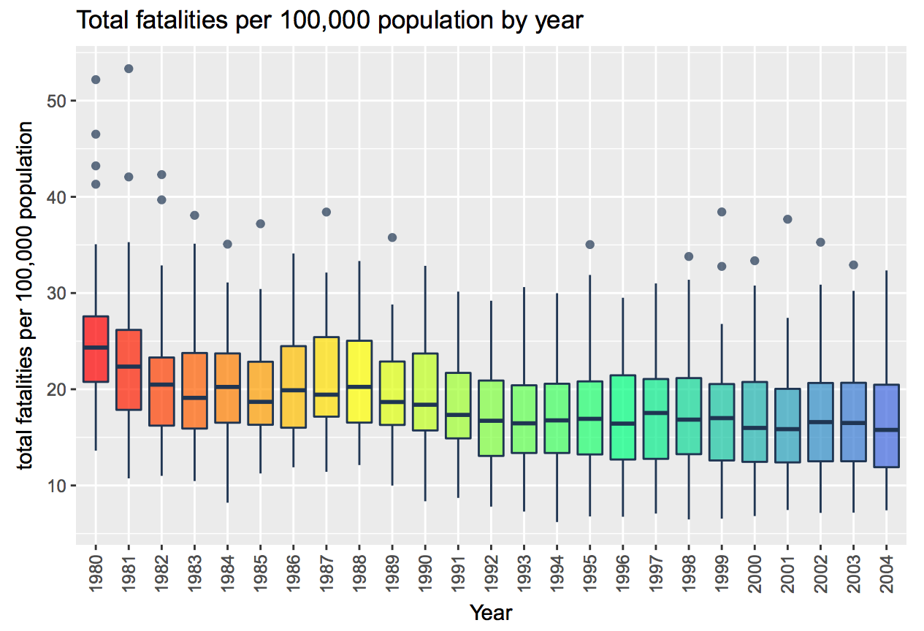
Fatalities from Driving (R ggplot)

Slide 5
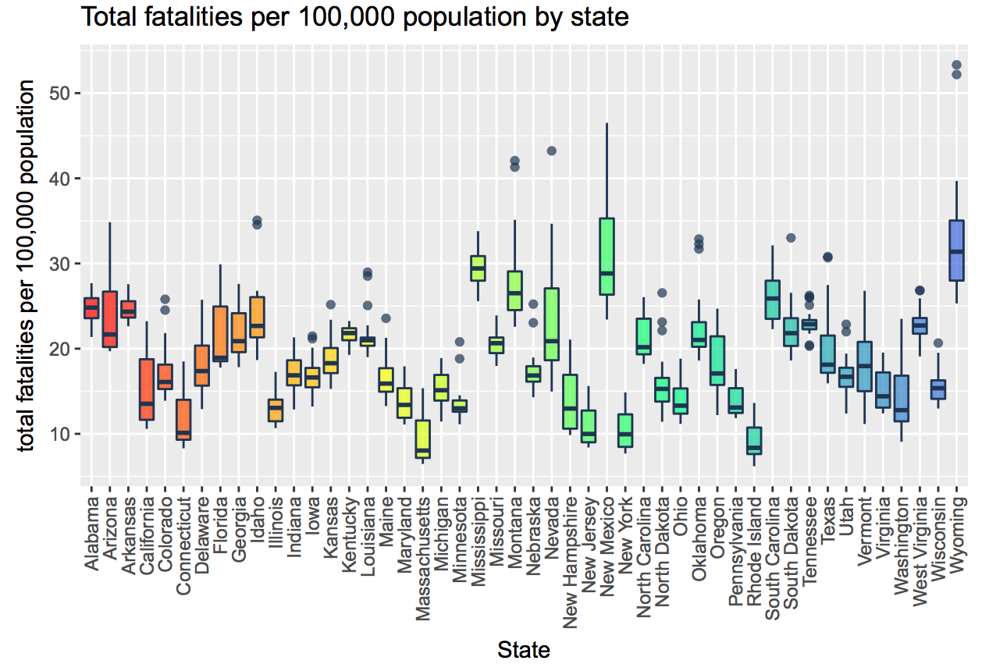
Fatalities from Driving (R ggplot)

Slide 6
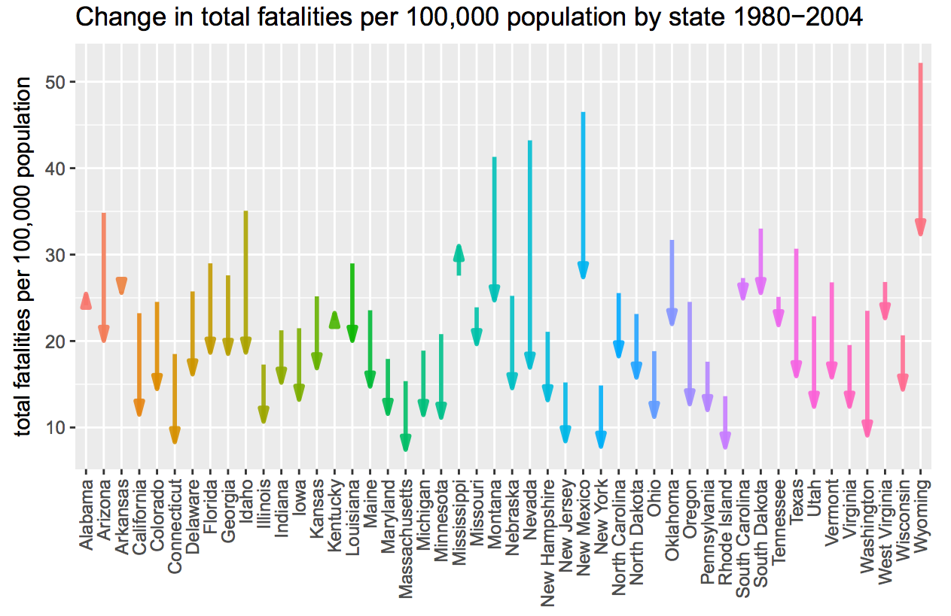
Fatalities from Driving (R ggplot)

Slide 7
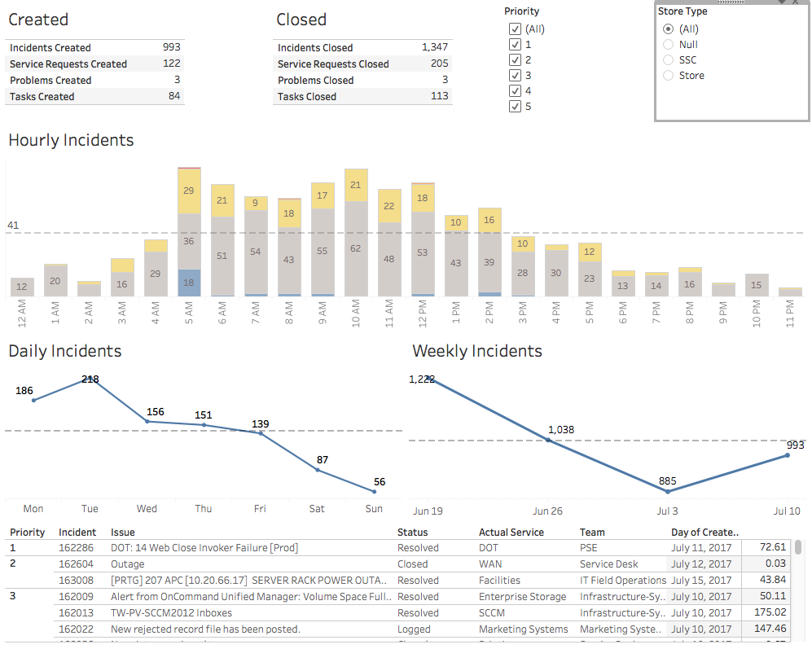
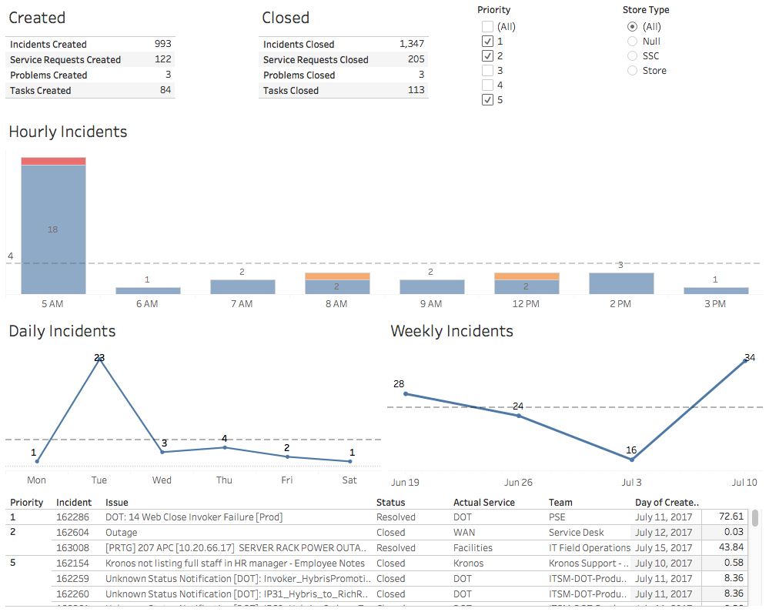
IT Request Management Dashboard (Tableau)
All Priorities
Priorities 1,2,5

Slide 8
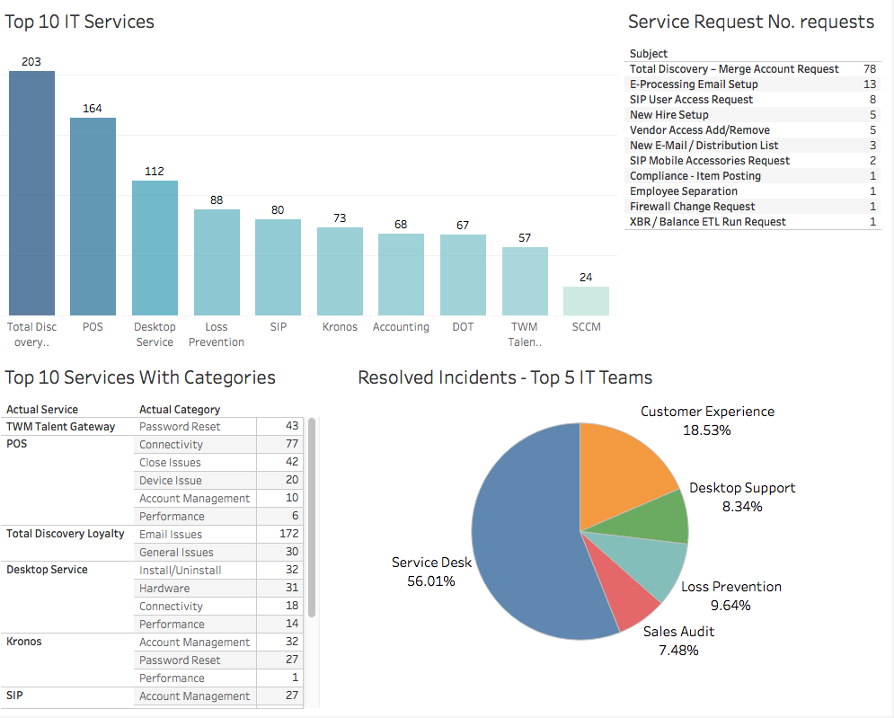
IT Request Management Dashboard (Tableau)

Slide 9
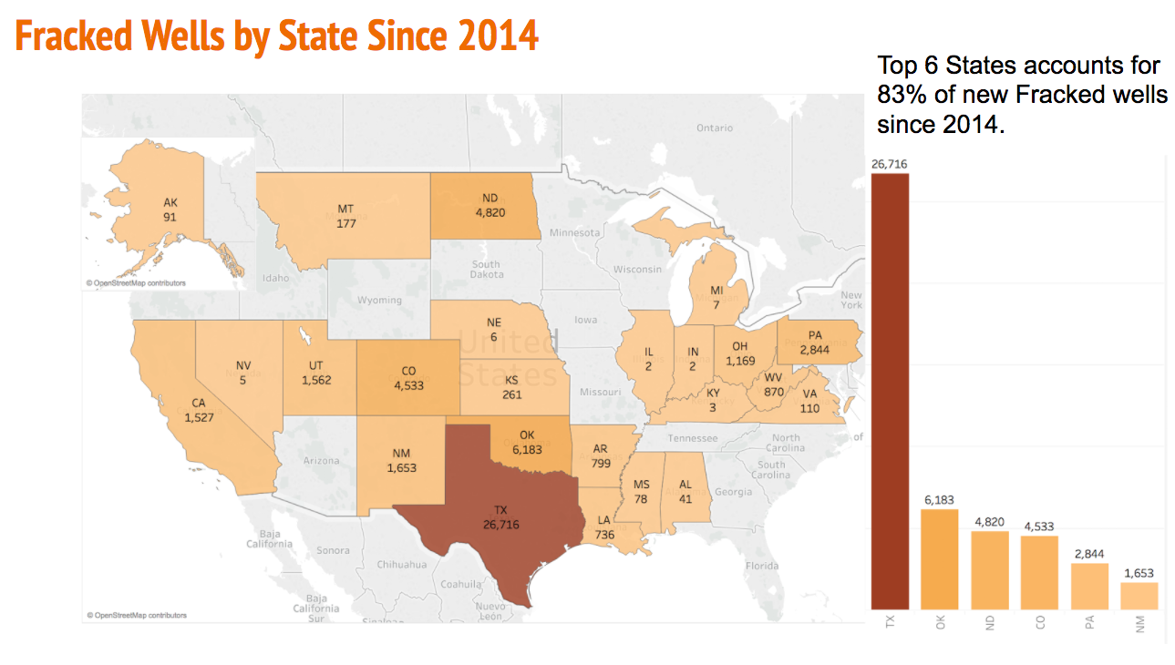
Fracked Wells and Earthquakes (Tableau)

Slide 10
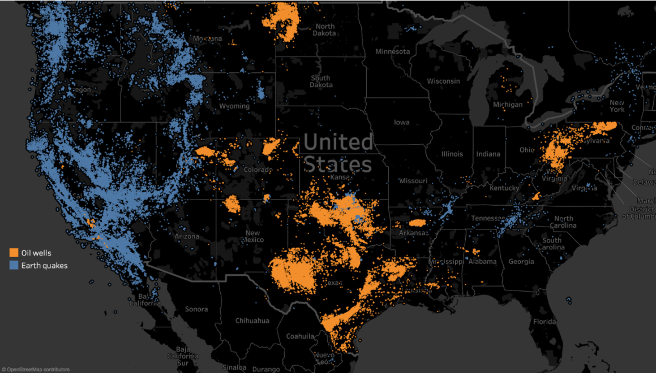
Fracked Wells and Earthquakes (Tableau)

Slide 11
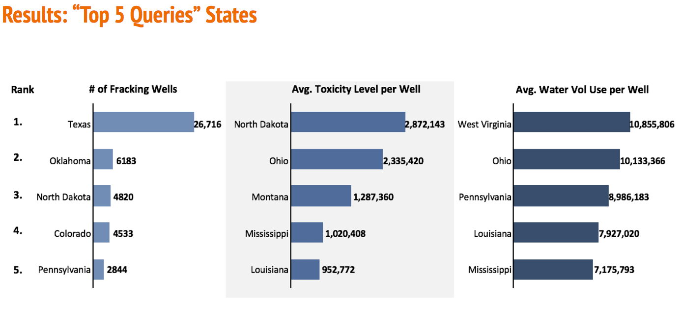
Fracked Wells and Earthquakes (Tableau)

Slide 12
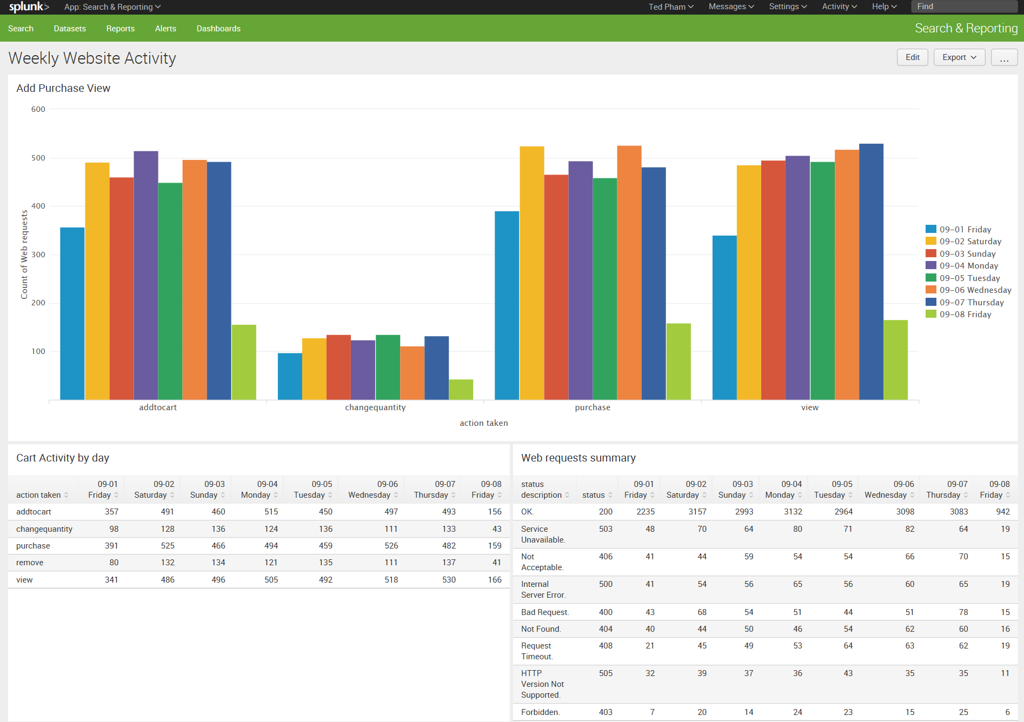
Custom Dashboard from generated Data (Splunk)

